Slide 1






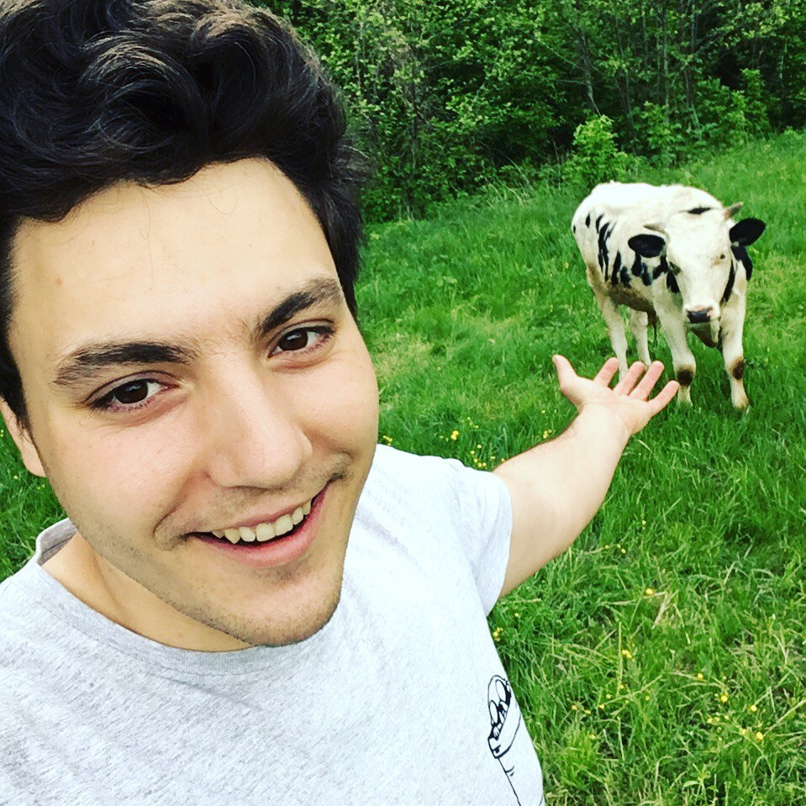
_{Voluntary help}
_{for Sandnessjøen high school}
Subjects
Math
Physics
Computer Science
Wellbeing
Table-tennis
Self-development
Life Understanding
Free topic
Contacts Sasha Freedom (Oleksandr Kryvonosov)
@sashathefreedom
+47 413 53 265
sahlet.no@gmail.com

